Slide 1
Data Communication and Computer Networks (CCE-2102)
By: Dr. Lal Pratap Verma

Slide 2
Error Detection and Correction
Errors:
Whenever bits flow from one point to another, they are subject to unpredictable changes because of interference.
This interference can change the shape of the signal.
Type of Error:
In a single-bit error, 0 is changed to 1 or 1 to 0.
In a burst error, multiple bits are changed.
Some applications require that errors be detected and corrected.

Slide 3
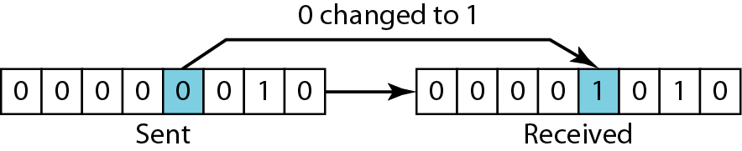
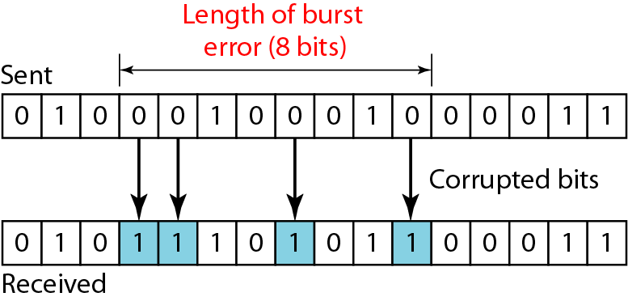
Error Detection and Correction
Type of Error:
Single Bit Error
Burst error

Slide 4
Error Detection and Correction
Error Detection Methods
To detect errors, a common technique is to used that is redundancy bits which provide additional information.
Various techniques for error detection include:
Simple Parity Check
Two-Dimensional Parity Check
Checksum
Cyclic Redundancy Check (CRC)

Slide 5
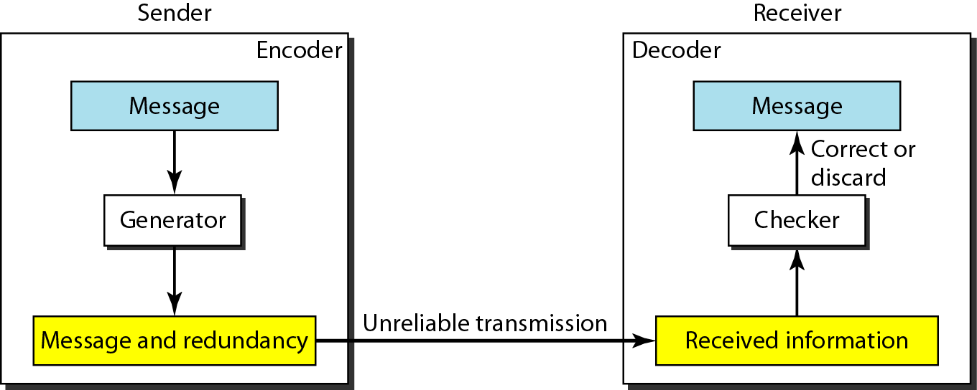
Error Detection and Correction
Redundancy:
To detect or correct errors, we need to send extra (redundant) bits with data.

Slide 6
Error Detection and Correction
Redundancy:
To detect or correct errors, we need to send some extra bits with our data.
These redundant bits are added by the sender and removed by the receiver.
Their presence allows the receiver to detect or correct corrupted bits
The correction of errors is more difficult than the detection. In error detection, we are
looking only to see if any error has occurred. The answer is a simple yes or no.
A single-bit error is the same for us as a burst error.

Slide 7
Error Detection and Correction
Redundancy:
In error correction, we need to know the exact number of bits that are corrupted and more importantly, their location in the message.
The number of errors and the size of the message are important factors.
If we need to correct one single error in an 8-bit data unit, we need to consider eight possible error locations; if we need to correct two errors in a data unit of the same size, we need to consider 28 possibilities.
You can imagine the receiver's difficulty in finding 10 errors in a data unit of 1000 bits

Slide 8
Error Detection and Correction
Simple Parity Check
Simple-bit parity is a simple error detection method that involves adding an extra bit to a data transmission. It works as:
1 is added to the block if it contains an odd number of 1’s, and
0 is added if it contains an even number of 1’s
This scheme makes the total number of 1’s even

Slide 9
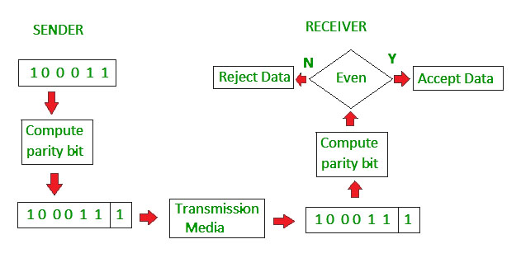
Error Detection and Correction
Simple Parity Check

Slide 10
Error Detection and Correction
Simple Parity Check
Advantages
Easy to implement in both hardware and software.
Only one additional bit (the parity bit) is added per data unit
Fast Error Detection
Single-Bit Error Detection

Slide 11
Error Detection and Correction
Simple Parity Check
Disadvantages
Single Parity check is not able to detect even no. of bit error.
For example, the Data to be transmitted is 101010. Codeword transmitted to the receiver is 1010101 (we have used even parity).
Let’s assume that during transmission, two of the bits of code word flipped to 1111101.
On receiving the code word, the receiver finds the no. of ones to be even and hence no error, which is a wrong assumption.

Slide 12
Error Detection and Correction
Two-Dimensional Parity Check
Two-dimensional Parity check bits are calculated for each row, which is equivalent to a simple parity check bit.
Parity check bits are also calculated for all columns, then both are sent along with the data.
At the receiving end, these are compared with the parity bits calculated on the received data.

Slide 13
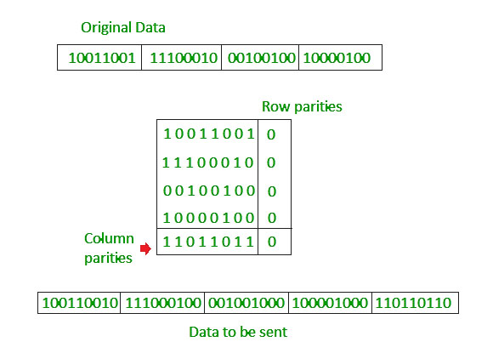
Error Detection and Correction
Two-Dimensional Parity Check

Slide 14
Error Detection and Correction
Drawbacks Of Two-Dimensional Parity Check
If two bits in one data unit are corrupted and two bits exactly the same position in another data unit are also corrupted, then 2D Parity checker will not be able to detect the error.
This technique cannot be used to detect the 4-bit errors or more in some cases.

Slide 15
Error Detection and Correction
Checksum:
A Checksum is an error detection technique based on the concept of redundancy.
The process involves dividing the data into equally sized segments and using a 1’s complement to calculate the sum of these segments.
The calculated sum is then sent along with the data to the receiver.
At the receiver’s end, the same process is repeated and if all zeroes are obtained in the sum, it means that the data is correct.

Slide 16
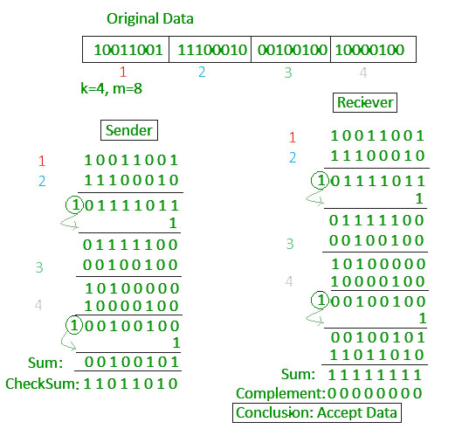
Error Detection and Correction
Checksum:

Slide 17
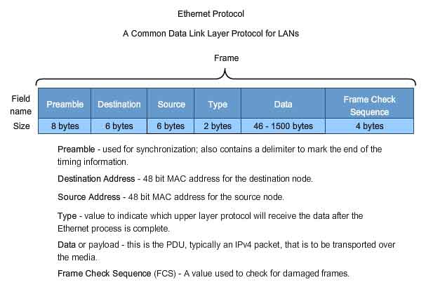
Error Detection and Correction
Checksum:
Frame format
Field | Size | Description
Preamble | 7 Bytes | Synchronization sequence for receivers
Start Frame Delimiter | 1 Byte | Marks the start of the frame
Destination MAC | 6 Bytes | Address of the destination device
Source MAC | 6 Bytes | Address of the sending device
EtherType/Length | 2 Bytes | Indicates protocol (e.g., IPv4) or payload length
Payload/Data | 46-1500 Bytes | The actual data or payload being carried
Frame Check Sequence | 4 Bytes | Error detection using CRC

Slide 18
Error Detection and Correction
Cyclic Redundancy Check:
Cyclic codes are special linear block codes with one extra property. In a cyclic code, if a codeword is cyclically shifted (rotated), the result is another codeword.

Slide 19
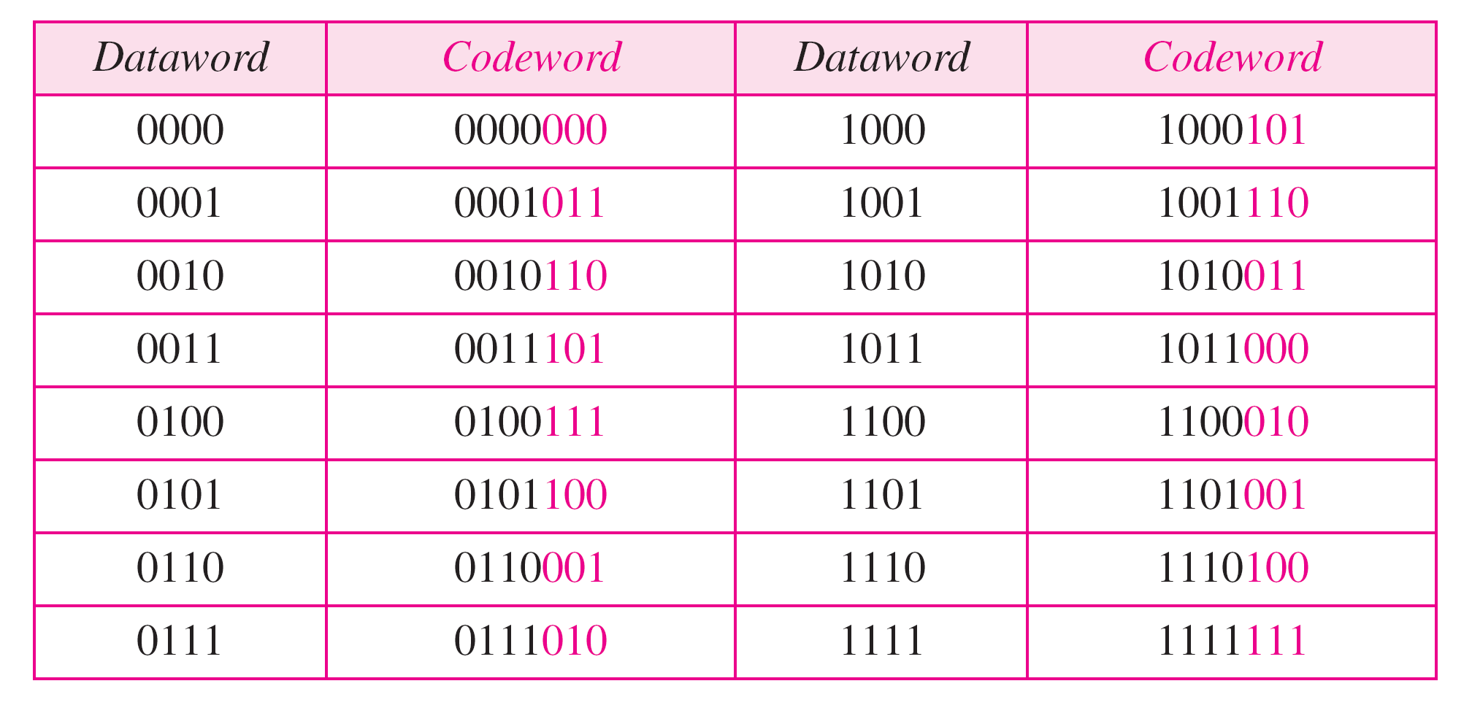
Error Detection and Correction
Cyclic Redundancy Check:
A CRC code with C(7, 4)

Slide 20
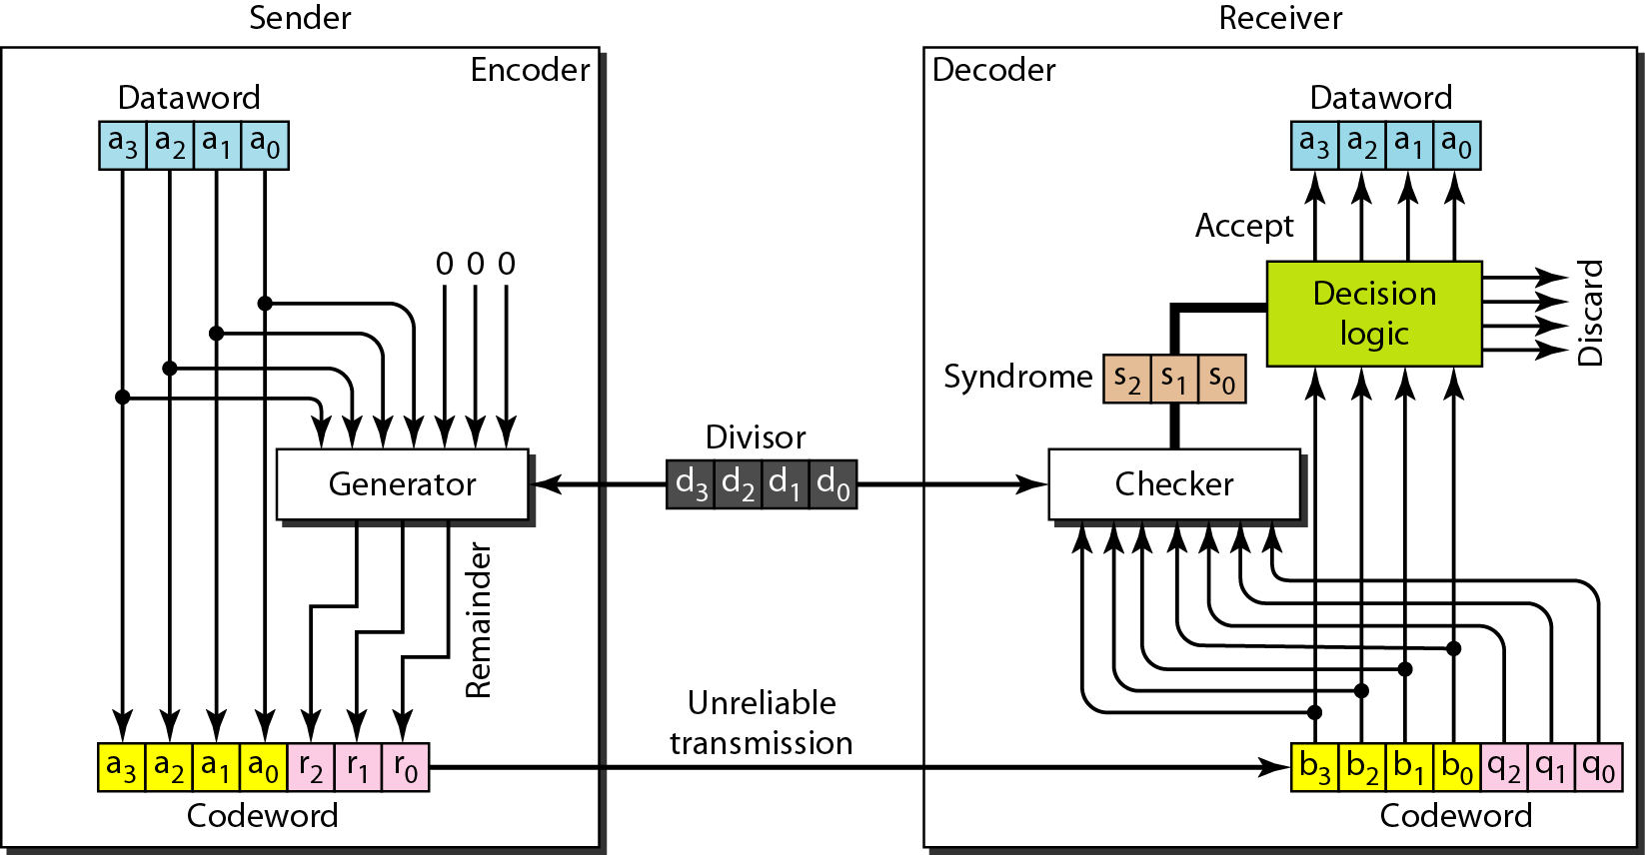
Error Detection and Correction
Cyclic Redundancy Check:

Slide 21
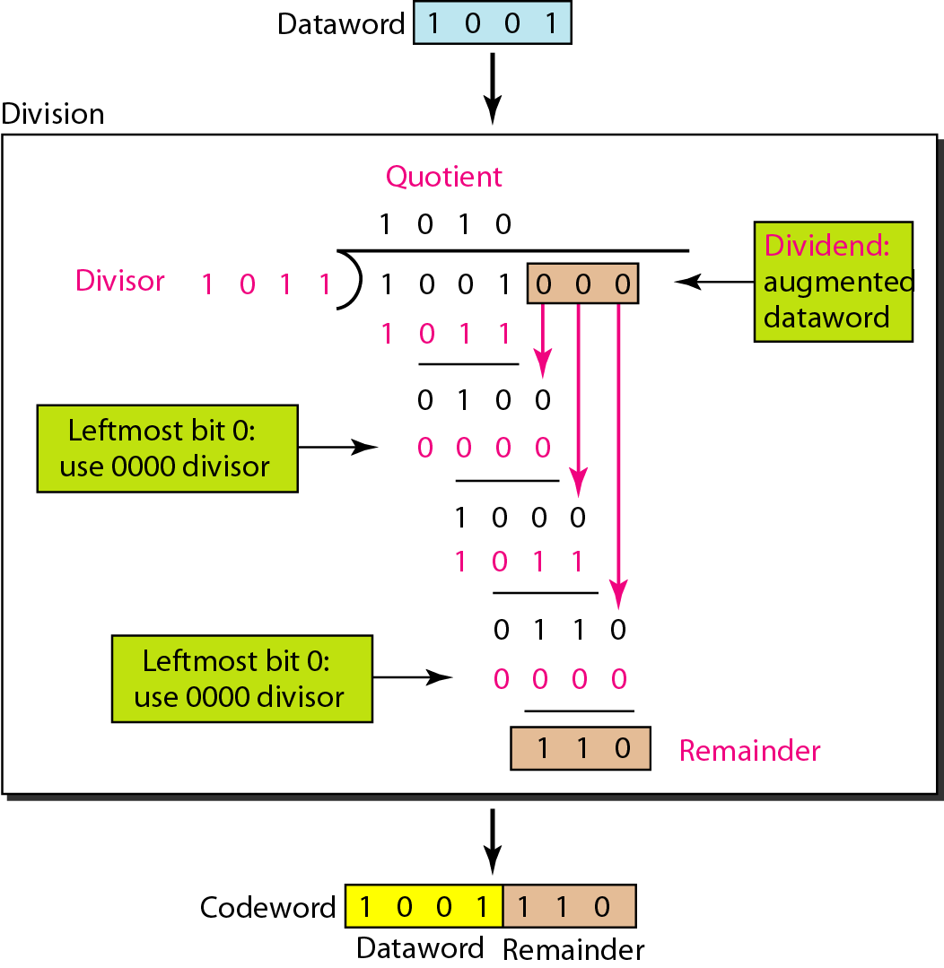
Error Detection and Correction
Cyclic Redundancy Check:

Slide 22
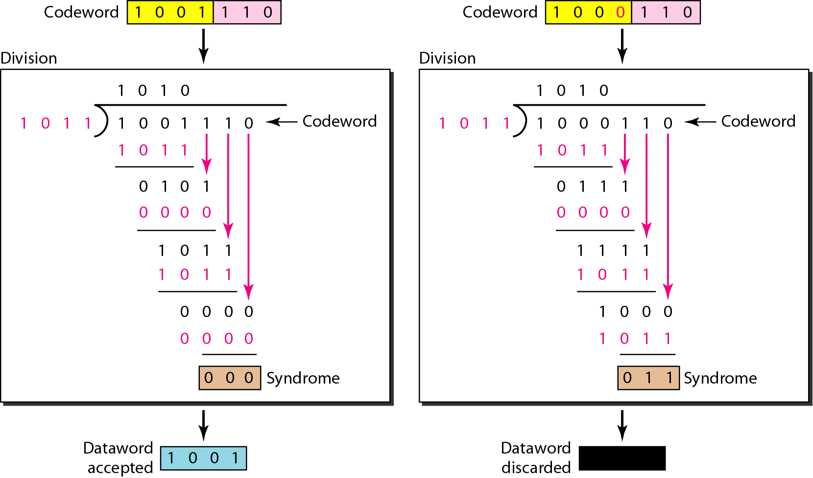
Error Detection and Correction
Cyclic Redundancy Check:

Slide 23
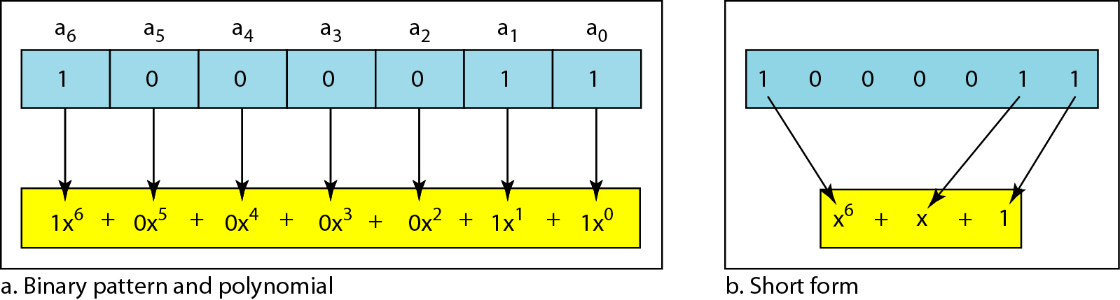
Error Detection and Correction
Using Polynomials:
We can use a polynomial to represent a binary word.
Each bit from right to left is mapped onto a power term.
The rightmost bit represents the “0” power term. The bit next to it the “1” power term, etc.
If the bit is of value zero, the power term is deleted from the expression.

Slide 24
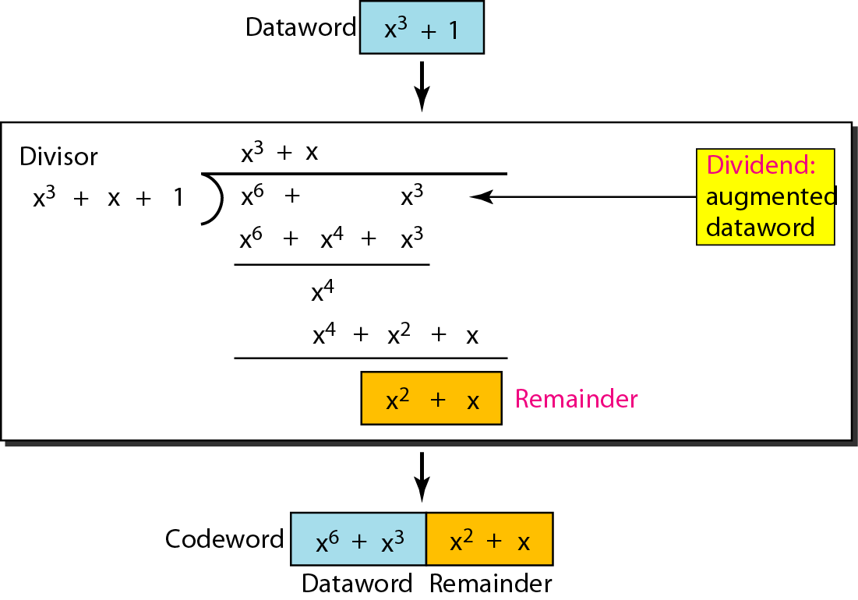
Error Detection and Correction
CRC division using polynomials:

Slide 25
Error Detection and Correction
CRC division using polynomials:
The divisor in a cyclic code is normally called the generator polynomial or simply the generator.
In a cyclic code,
If s(x) ≠ 0, one or more bits are corrupted.
If s(x) = 0, either
a. No bit is corrupted. or
b. Some bits are corrupted, but the decoder failed to detect them.

Slide 26
Error Detection and Correction
Error Correction can be handled in two ways:
Backward error correction: Once the error is discovered, the receiver requests the sender to retransmit the entire data unit.
Forward error correction: In this case, the receiver uses the error-correcting code which automatically corrects the errors.
A single additional bit can detect the error but cannot correct it
For correcting the errors, one has to know the exact position of the error.
For example, If we want to calculate a single-bit error, the error correction code will determine which one of the seven bits is in error. To achieve this, we have to add some additional redundant bits.

Slide 27
Error Detection and Correction
Hamming Code
Parity bits: The bit which is appended to the original data of binary bits so that the total number of 1s is even or odd.
Even parity: To check for even parity, if the total number of 1s is even, then the value of the parity bit is 0. If the total number of 1s occurrences is odd, then the value of the parity bit is 1.
Odd Parity: To check for odd parity, if the total number of 1s is even, then the value of parity bit is 1. If the total number of 1s is odd, then the value of parity bit is 0.

Slide 28
Error Detection and Correction
Hamming Code
2^{r}>=d+r+1
Algorithm of Hamming code:
An information of 'd' bits are added to the redundant bits 'r' to form d+r.
The location of each of the (d+r) digits is assigned a decimal value.
The 'r' bits are placed in the positions 1,2,.....2k-1.
At the receiving end, the parity bits are recalculated. The decimal value of the parity bits determines the position of an error.

Slide 29
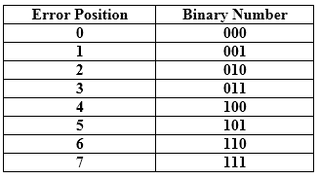
Error Detection and Correction
Relationship b/w Error position & binary number.

Slide 30
Error Detection and Correction
Example
Total number of data bits 'd' = 4
Number of redundant bits r : 2^{r} >= d+r+1 2^{r}>= 4+r+1
Therefore, the value of r is 3 that satisfies the above relation.
Total number of bits = d+r = 4+3 = 7;

Slide 31

Error Detection and Correction
Determining the position of the redundant bits
The number of redundant bits is 3.
The three bits are represented by r1, r2, r4.
The position of the redundant bits is calculated with corresponds to the raised power of 2.
Therefore, their corresponding positions are 1, 2¹, 2².

Slide 32
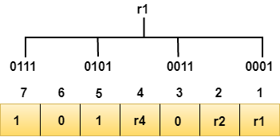
Error Detection and Correction
Determining the Parity bits
Determining the r1 bit
The r1 bit is calculated by performing a parity check on the bit positions whose binary representation includes 1 in the first position.
Observe from the above figure that the bit positions that includes 1 in the first position are 1, 3, 5, 7. Now, we perform the even-parity check at these bit positions. The total number of 1 at these bit positions corresponding to r1 is even, therefore, the value of the r1 bit is 0.

Slide 33
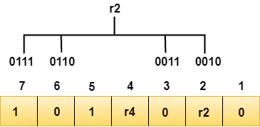
Error Detection and Correction
Determining the r2 bit
The r2 bit is calculated by performing a parity check on the bit positions whose binary representation includes 1 in the second position.
Observe from the above figure that the bit positions that includes 1 in the second position are 2, 3, 6, 7. Now, we perform the even-parity check at these bit positions. The total number of 1 at these bit positions corresponding to r2 is odd, therefore, the value of the r2 bit is 1.

Slide 34
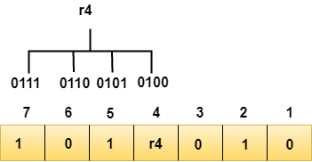
Error Detection and Correction
Determining the r4 bit
The r4 bit is calculated by performing a parity check on the bit positions whose binary representation includes 1 in the third position.
Observe from the above figure that the bit positions that includes 1 in the third position are 4, 5, 6, 7. Now, we perform the even-parity check at these bit positions. The total number of 1 at these bit positions corresponding to r4 is even, therefore, the value of the r4 bit is 0.

Slide 35

Error Detection and Correction
Data transferred is given below:
Suppose the 4th bit is changed from 0 to 1 at the receiving end, then parity bits are recalculated.

Slide 36
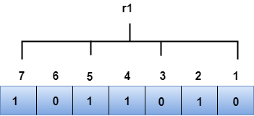
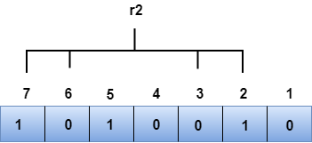
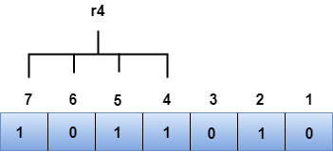
Error Detection and Correction
Data transferred is given below:
Suppose the 4th bit is changed from 0 to 1 at the receiving end, then parity bits are recalculated.
The binary representation of redundant bits, i.e., r4r2r1 is 100, and its corresponding decimal value is 4. Therefore, the error occurs in a 4th bit position. The bit value must be changed from 1 to 0 to correct the error.

Slide 37
References
W. Stallings, Data and Computer Communications, (10e), Pearson Education, 2014.
B. A. Forouzan, Data Communications & Networking, (5e), McGraw Hill, 2013.
D. P. Bertsekas, R. G. Gallager, Data Networks, (2e), Prentice Hall of India, 2011.
A. S. Tenenbaum, Computer Networks, (5e), Prentice Hall of India, 2008.
L. L. Peterson, B. S. Davie, Computer Networks: A Systems Approach, (5e), Morgan Kaufmann Publishers, 2011.

